Slide 1
13.4 The Troubled Church
By: Miranda Adams, Emily Null, Austin Patrick, and Kyle Woosley

Slide 2
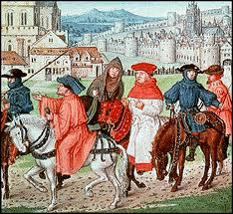
Pilgrimages

Slide 3
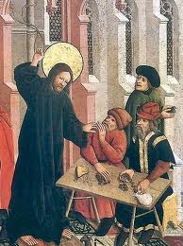
Simony

Slide 4
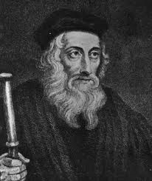
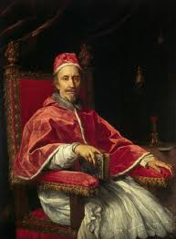
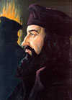
Pope Clement V:
Born Raymond Bertrand de Got
Born in 1264-Died 1534
French archbishop
John Wycliffe: Born 1320-Died 1384 A scholar at England’s Oxford University.
Jan Hus: Born : 1369 died- 1415
preacher
professor at the University of Prague
Reformer
John Wycliffe
Significant people:
Jan Hus
Pope Clement V

Slide 5
Additional Info.
Wycliffe wanted to see his ideas actualized--his fundamental belief was that the Church should be poor, as in the days of the apostles.
When Jan Hus was being burned at the stake, the council usually faces them to the east, facing Jerusalem, but in Jan Hus case they faced him towards the West because that’s where the protestant religion was headed!
In 1929 Benito Mussolini wrote a sympathetic biography about Jan Hus.
Pope Clement V is considered the first Apostolic Father of the church.

Slide 6
Guided Reading:
1) Why did Pope Clement V move the papacy to France?
2) What was The Name given to describe the papacy’s exile in France?
3)How Did the Great Schism come about?
4)What were two results of the great schism?
5) What was another reason for people’s distrust and dislike of the church?
6)What three things about the church did John Wycliffe Criticize?
7) Why did the church not want Wycliffe to translate the Bible to English?
8) What 3 elements led to the environment in which Jan Hus became important?
9)What situation led to Jan Hus being burned on his way to Constance?
10) After the crusades against the Hussites and the compromise in A.D 1436, what was a lasting result of the Hussite Movement?

Slide 7
Work Cited!
http://www.albalagh.net/kids/history/church_decline.shtml
http://www.greatsite.com/timeline-english-bible-history/john-wycliffe.html
http://www.encyclopedia.com/topic/Clement_V.aspx

