Slide 1
Italian Renaissance 16-1.
Miranda Adams, Austin Patrick, Emily Null, Kyle Woosley.

Slide 2
Key Terms.
Secular- Non-religious
Humanism- the realization that people are more important than religion
Individualism- Individuality, being self reliant.
Sonnet-14 line poem. “Shall I compare thee to a summers day?” by William Shakespeare is a sonnet.
K

Slide 3
Shall I compare thee to a summers day?
E

Slide 5
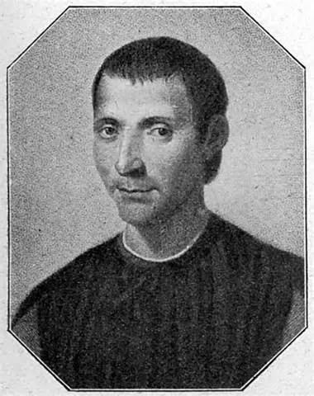
People
Niccolo Machiavelli:
Born in Florence.
chancellor and secretary of the second
chancellory of the Florentine
republic.
M

Slide 6
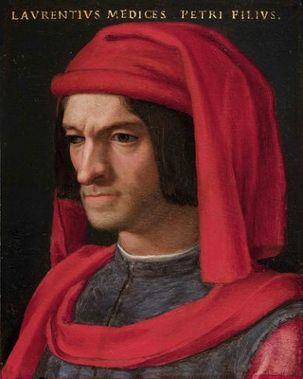
People Continued
Lorenzo de Medici.
Ruled Florence from 1469-1492
Continued the politics like those of his grandfather.
Known as “The Magnificent”
**Fun Fact** His family produced 2 queens, 3 popes and several cardinals.
A

Slide 7
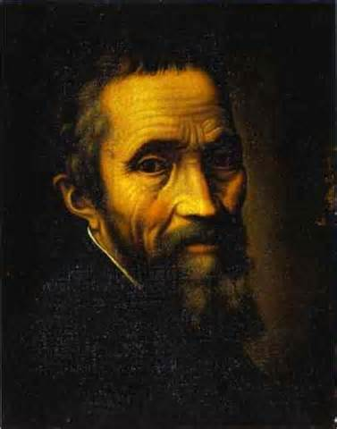
People
Michelangelo Buonarroti.
March 6,1475-February 18, 1564 sculpted works for the pope.
learned his craft In florence
Painted the ceiling of the Sistine Chapel.
**Fun Fact** It was a 24 year time gap between the completion of the ceiling, and the beginning of the “Last judgment” .
K

Slide 8
People. continued
Leonardo Da Vinci-
Born April 15th, 1452. Died May 2nd 1519.
Established his own workshop at age 20.
Painted the “The Last Supper”, and “The Mona Lisa”.
**Fun Fact**- It took Da Vinci 10 years to paint Mona Lisa’s lips!
E

Slide 9
Is it him?
Leonardo Da Vinci painted the Mona Lisa about 500 years ago.
This is arguably the most famous painting ever made.
Everyone thinks this is him in drag.
M

Slide 10
Additional information
End of 14th century was a “Rebirth”
Humanism encouraged people to start being curious, and learn more about the nature and earthly ways. Renaissance artists and architects used humanistic ideas in there structures.
Renaissance era writers were able to relax and enjoy worldly pleasures due to the patronage of the wealthy.

Slide 11
…Still additional information
Art was at a huge point in the world at this time.
Used Greek and roman classical styles. “Classical”.
The Medici family came to hold wealth and political power by dominating banking and merchant careers.
A

Slide 13
cites
"Italian Renaissance." History.com. A&E Television Networks,
Web. 01 Apr. 14

