Slide 1
16.2 The Northern Renaissance
BY: Curtis Rigdon
Matthew Schimsa
David Webb
Krysten collins

Slide 2
Key Term
Chateaux- Castles

Slide 3
People
Johannes Gutenberg: Created the printing press; made copying important documents, like the bible, a lot faster and easier, important man in history
Francois Rabelais: Famous author of the renaissance; often wrote comic tales, satires, and parodies
Desiderius Erasmus: Famous Christian humanist; inspired colleagues to study Greek and Hebrew for better understanding of the earlier versions bible

Slide 4
People
Pieter Brueghel: combined Italian technique with the artistic traditions of there homelands. They painted realistic portraits, religious themes, landscapes, and scenes of daily life.
Thomas More: he was an English humanist author wrote a book that criticized society of his day with an ideal which all citizens are equal and prosperous.
William Shakespeare: famous play writer. Drew his ideas from medieval classic mythology and the history of England, Denmark, ancient Rome. Possible the best poet in history.

Slide 5
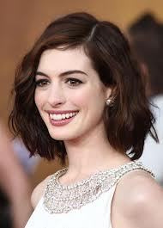
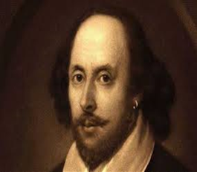

William Shakespeare
William Shakespeare was a Christian born on April 23, 1564, and was baptized about 3 days later. He was the son of John Shakespeare and Mary Arden and had 2 older sisters and 3 younger brothers. When he was 18, he married Anne Hathaway when she 26, on November 28, 1582 and they had 3 children together. William started his theatrical career in estimated 1592. He is most known for his plays such as “taming of the Shrew,” “Julius Caesar,” “Romeo and Juliet,” and “Hamlet.”

Slide 6
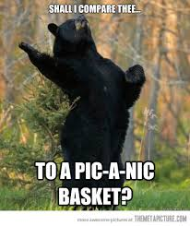
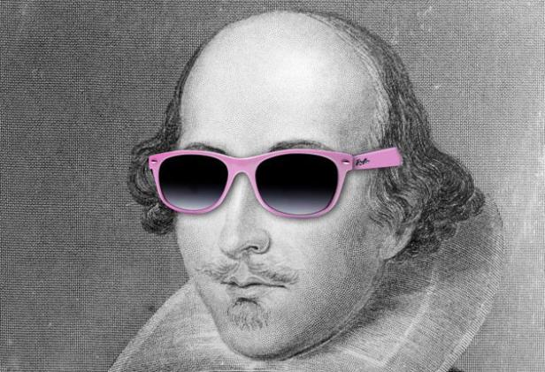
Extensive Information
English, French, and Italian renaissance
War helps spread ideas by furthering contact between people of different cultures.
Shakespeare is called the Bard of Avon witch means “ A Poet from Avon;” Avon is where he was born.
=

Slide 7
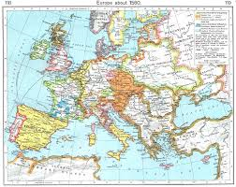
Map

Slide 8
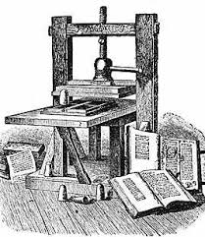
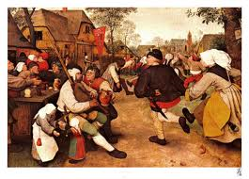
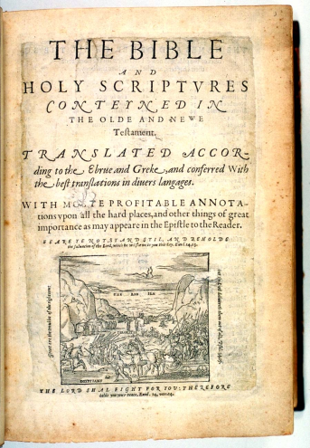

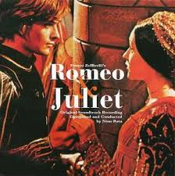
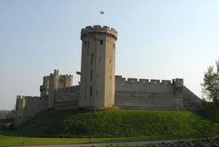
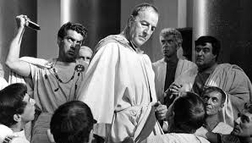
Images

Slide 9
Fun facts
Northern renaissance actually means within Europe but out side of Italy.
Biggest impact the renaissance had was a religious revolution
The result was from corruption within the church and rising power of Kings at the expense of Popes in the church.
These factors lead to the Protestant reformation
Protestant reformation=means a new way of seeing things

Slide 10
WORK CITED
Butler, Chris . "The Northern Renaissance (c.1500-1600)." FLOWOFHISTORY. 2007. 2007. <http://www.flowofhistory.com/units/west/11/FC78>.
Clarke, Michael . "1400-1500 Renaissance in Italy and the North." Smart History. 2011. 2012. <http://smarthistory.khanacademy.org/1400-1500-Rena>.
Esaak, Shelley . "ART History." Northern Renaissance. 2014. 2014. <http://arthistory.about.com/cs/arthistory10one/a/n>.
"The Northern Renaissance of European Art." About.com.
Urten, Robern . "The Northern Renaissance." EyeConArt. 2008. 2008. <http://www.robinurton.com/history/Renaissance/nort>.

