Slide 1
The Protestant Reformation
Section 16.3
By: Mitchell Freeman, Jon Fowler, James Gan, and Isaiah Bell

Slide 2
Key Terms
Justification by faith - known as Luther's idea.
Indulgences - certificates issued by the church.
Vocations - A calling from God to take up certain work.

Slide 3
People
Martin Luther
born in 1483,
created justification by faith alone,
caused conflict with the church,
preached against indulgences
Pope Leo X
authorized indulgences,
rebuilt St. Peter’s Basilica
* Key People
* Key Terms

Slide 4
Additional Information
Creation of the printing press in the 1400s
Luther became a monk and struggled with salvation
Luther also attacked indulgences in general
Luther studied law at Orleans and Greek art at Bourges
Luther nailed a copy of the ninety-five thesis to the door at the church at Wittenberg

Slide 5
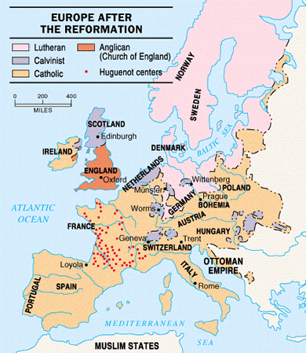
Map

Slide 6
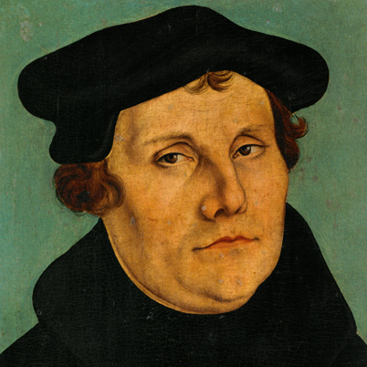
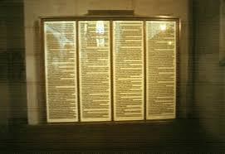
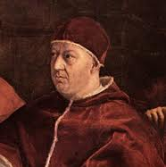
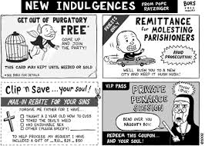
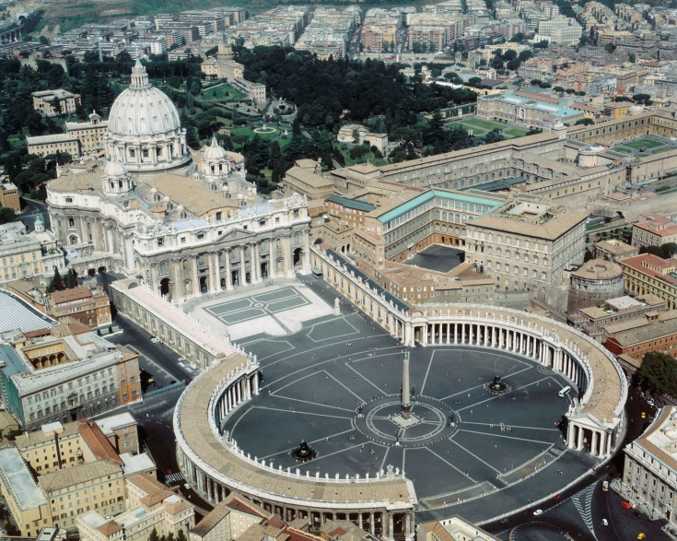
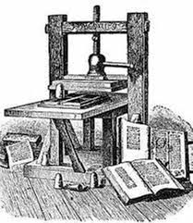
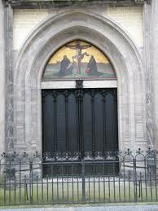
Images
Martin Luther
95 Thesis
Pope Leo X
Indulgences
St. Peter’s Basilica
15th Century Printing Press
Door of the Church of Wittenberg

Slide 7
Works Cited
"The Reformation." History.com. A&E Television Networks, Web. 02 Apr. 2014.

