Slide 1
Section 16-4: the spread of Protestantism
By Dalton Duncan Tyler Greer eran Walters and Sadie Johnson

Slide 2
Key terms
Theocracy- church run state
Predestination- god determines the fate of every person

Slide 3
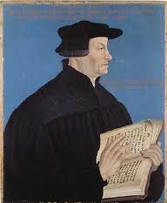
People to know
Huldrich Zwingli
Born 1484
Death 1531
Swiss priest
Led protestant movement
Established a theocracy

Slide 4
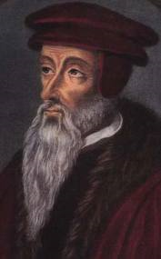
People to know
John calvin
Born 1509
Death 1564
Established reformed group in Geneva
Published the institutes of Christian religion

Slide 5
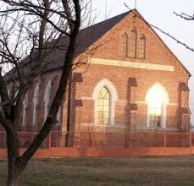
People to know
The Anabaptist
Adults only
New group
Denied authority of local authority
Peaceful people

Slide 6
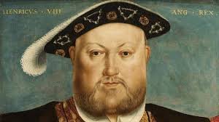
People to know
Henry VIII
Born June 28 1491
Died 1509
Ideas of reformation
Catharine of Aragon had six kids
Mary survive
wants a male heir
Married Anne Boleyn to have a boy

Slide 7
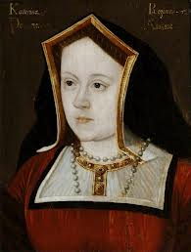
People to know
Catherine of Aragon
Born- December 16, 1485
Married: prince Arthur Nov 14, 1501(widowed) king henry VIII June 11, 1509
Divorced king henry VIII 1533
Died on January 7,1536
Buried on January 29, 1536
She also had a miscarriage

Slide 8
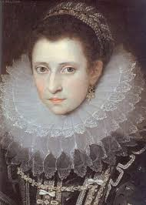
People to know
Anne Boleyn
Born- between 1500+1509
Married to henry VIII: jan 25, 1533
Executed: may 19,1536
The “6th finger large mole” girl
Not one of the best looking girl in the world
Moderately pretty

Slide 9
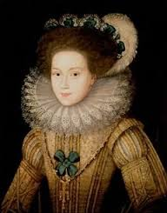
People to know
Queen “Bloody” Mary
Born 1516
Death 1558
Known as bloody Mary
Tried to restore Catholicism
Burned hundreds of protestants

Slide 10
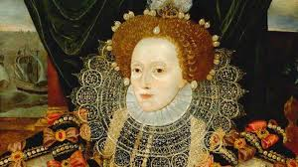
People to know
Elizabeth I
Born 1533
Death 1603
Crowned in 1558
Made church of England protestant

Slide 11
Places to locate

Slide 12
Works cited
Anne Boleyn. Digital image. Sirthomaswhatt.com., 15 July 2013. Web. 9 Apr. 2014.
Bloody Mary. Digital image. Sirthomaswhatt.com., 15 July 2013. Web. 9 Apr. 2014.
Elizabeth I. Digital image. History. Bbc, 2014. Web. 9 Apr. 2014.
Cathrine of aragon. Digital image. History. Bbc, 2014. Web. 9 Apr. 2014.
Henry VIII. Digital image. History. Bbc, 2014. Web. 9 Apr. 2014.
"Henry VIII." History. Bbc, 2014. Web. 9 Apr. 2014.
Mckinght, Scot. Anabantist church. Digital image. The Originial Third Way: Anababtism. Beleifnet, 2010. Web. 9 Apr. 2014.
John calvin. Digital image. Biographical Sketch. Covenanter, 2008. Web. 9 Apr. 2014.

