Slide 1
16.5 The Catholic
Reformation
By: Ryan Weertz
Zoe Mosher
Brandy Cordora
BreAnna Slape

Slide 2
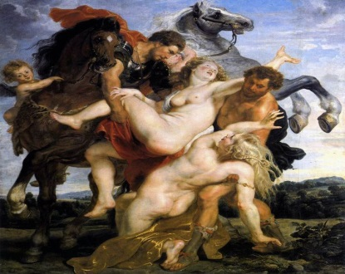
Key Terms!
Seminary
A theological school
The council of Trent put an end to church abuses-forbidding the selling of indulgences.
The clergy were ordered to follow strict rules of behavior which led the council to decide that each diocese had to establish a seminary.
Baroque
A new style of art and architecture
Baroque is more of a transition into the renaissance
arts from more of a “reformation” art.
Sparked specifically by the catholic reformation
Used to further the catholic reformation

Slide 3
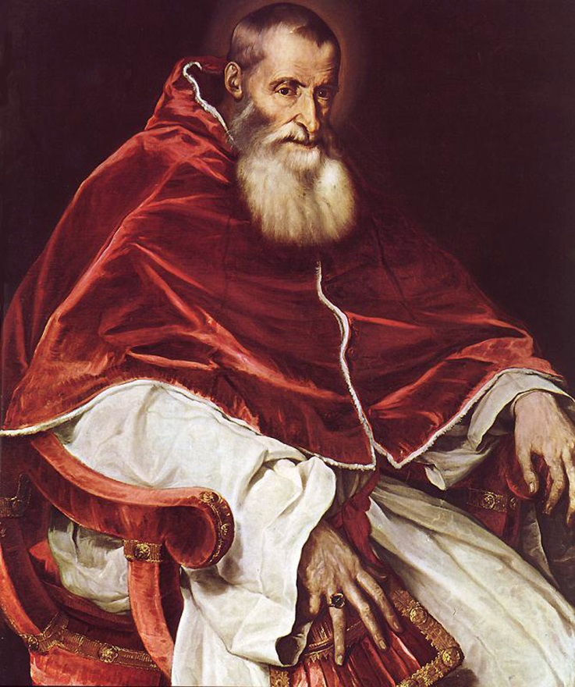
Significant People!
Pope Paul III
Set out to reform the church
Stem the protestant advance in the 1530’s and 1540’s
Called the council of bishops at Trent. Italy in 1545 to establish the goals of the catholic church
Strengthened the inquisition

Slide 4
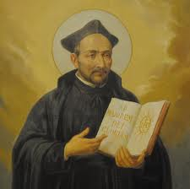
Ignatius of Loyola
Founded the Jesuits by following a strict spiritual discipline and pledged absolute obedience to the popes in 1540
He was a Spanish noble whose military career ended abruptly when he was wounded in battle
In recovery, he
found comfort in
saints who served
God
The Jesuits
Society of Jesus
Recognized by the pope in 1540
Worked to spread Catholicism and combat heresy
Preached to people, set up schools, helped the poor, and they served as advisors.

Slide 5
Extensive Information
Reformation began with Henry VIII’s quest for a male heir.
The Council of Trent
Met several sessions up until 1563
Salvations is said to come through faith and good works
Put an end to many church abuses
The Arts
Many artists influenced by the emotional devotion of the Catholic Reformation
Renaissance arts showed restraint, simplicity, and order

Slide 6
Teresa of Avila
A nun, was a supporter of Catholic renewal
Born into a noble family in 1515
Made a saint after her death, became known for her spiritual writings that rank among the classics of Christianity
A Divided Europe
Charles & German princes sign peace of Ausburg
Religious wars engulfed Europe
August 24th 1572, 30,000 French Protestants died

Slide 7
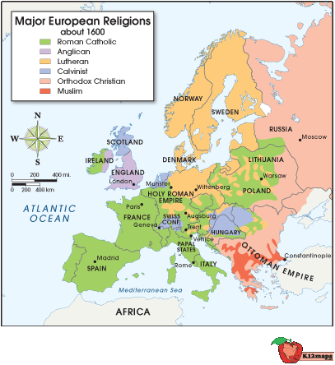

Slide 8
Word Cited
The Reformation - Facts & Summary. A&E Television Networks, 2014. Web. 7 Apr. 2014. <http://www.history.com/topics/reformation>.

