Slide 1
17.1 Early Explorations
BY: Blake Coleman, Nellie Maitland, Gabriella Savage, Reid Dauster

Slide 2
Key terms
Cartographer- Person who makes maps
Line of Demarcation- Imaginary line in the Atlantic Ocean, drawn by the Pope in 1493 to divide the world’s lands between Spain and Portugal
Circumnavigation- Circling of the globe

Slide 3
Prince henry the navigator
Son of King John I of Portugal.
Brought together map makers, mathematicians, and astronomers to study navigation.
Sponsored Portuguese exploratory voyages.
Discovered the Azores, Madeira Islands, and the Cape Verde Islands.

Slide 4
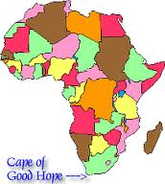
Bartholomeu Dias
Left Portugal in 1487 with the intent of finding the southern tip of Africa, Which he found in 1488
He later named it Cape of Good Hope
His expedition proved that ships could reach East Asia by sailing around Africa.
Additional Information
Born in 1450
Lost at sea in another expedition around the Cape of Good Hope in 1500.

Slide 5
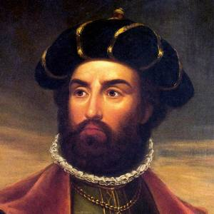
Vasco da gama
Led 4 ships in 1497 from Portugal for India
Went around the Cape of Good Hope landing in Calicut on the southwest coast of India In 10 Months
Tried to persuade ruler of Calicut and Muslim merchants to trade with Portugal but did not succeed.
Created a new water route to India
Additional Information
Born in Sines, Portugal around 1460.
Made two other voyages to India.
Died in 1524 in Cochin and was sailed back to Portugal and buried there in 1538.

Slide 6
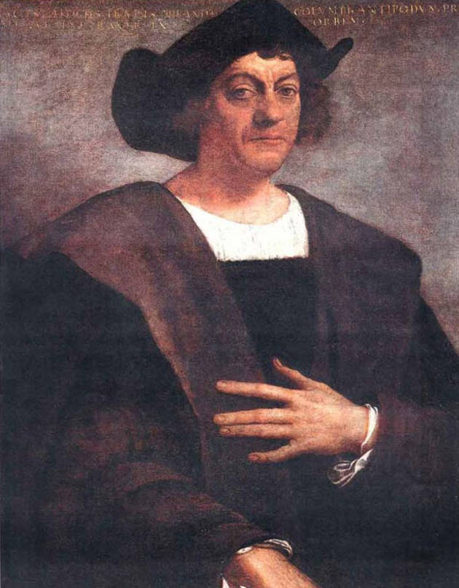
Christopher Columbus
An Italian navigator
Wanted to reach India by sailing west across the Atlantic
Set sail in 1492
He thought the distance would be 2200 miles
He called native islanders Indians
Spent three months exploring the islands
Additional Information
Born in 1451 in the Republic of Genoa
Almost lost his life in his first voyage in 1476 to the Atlantic Ocean.
Participated in several other expeditions to Africa

Slide 7
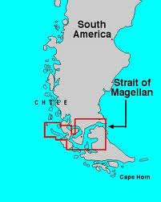
Ferdinand Magellan
Tried to find a western route to Asia.
The ships reached a narrow water passage now called the Strait of Magellan. (350 miles long)
Took 5 ships, one separated from the others and another one was ship wrecked.
Renamed the South Sea the Pacific Ocean because the water was so calm.
Ships finally reached present day Philippians.
Magellan was killed in a skirmish between a local chief and his enemy.
Additional Information
Born in Portugal circa 1480.
After Magellan’s death the remaining of his fleet returned to Spain proving the world was round.

Slide 8
Age of exploration
The Mongols could no longer guarantee safe passage for traders so Europeans were forced to the sea as a possible route to Asia.
Required sailors to be trained and required ships to be able to leave the sight of land and return home.
Inaccurate maps were another problem for sailors so map making gradually improved.
Innovations to ships such as multiple masses and triangle shaped sails made ships faster and moving the rudder to the ships stern made them more maneuverable.

Slide 9
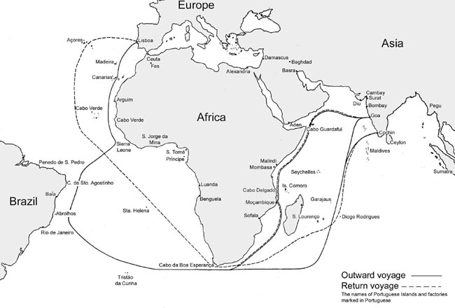

Slide 10
Portugal leads the way
First European country to venture out on the Atlantic ocean in search of spices and gold
Between 1420 and 1580 Portuguese captains pushed farther down the west coast of Africa
Brought mapmakers, mathematicians, and astronomers
1497 4 ships led by Vasco de Gama sailed from Portugal to India

Slide 11
Spain’s quests for riches
In late 1400’s Spain ended a long period of internal turmoil and wars against the moors.
Entered the race for Asian riches by backing the expedition of an Italian navigator named Christopher Columbus.
Once America was discovered both Spain and Portugal wanted to protect their claims so they turned to the pope for help and drew the line of Demarcation.
Spain got the West of the line and Portugal got the East.
1494 Spain and Portugal signed the Treaty of Tordesillas.

Slide 12
Works cited
"Vasco da Gama." 2014. The Biography.com. web. Apr 09 2014.
"Christopher Columbus." 2014. The Biography.com. web. Apr 09 2014.
"Bartolomeu Dias." 2014. The Biography.com. web. Apr 09 2014.
"Ferdinand Magellan." 2014. The Biography.com. web. Apr 09 2014.

