Slide 1
17.3- Changing Ways of Life
By: Raegan McDaniel, Darla Strader, Brandon “The Stud Muffin” Vatterott, Sierra Prince

Slide 2
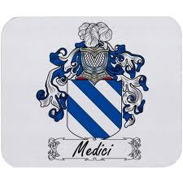
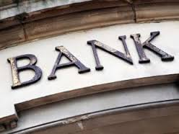
The Commercial Revolution
Joint-Stock Companies- trading venture that sold shares to divide costs and profits.
Entrepreneurs- person who undertakes risks to establish a business.

Slide 3
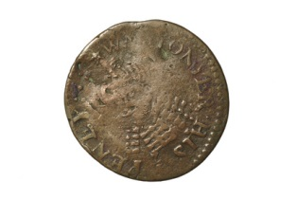
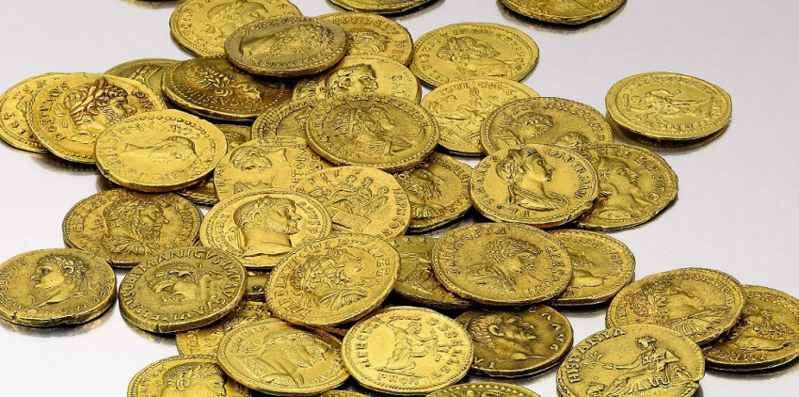
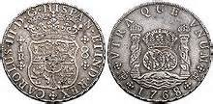
Mercantilism
Mercantilism was a new theory that every nation would use to gain wealth
Europeans measured wealth in bullion or the amount of gold and silver the nation held
Nations gained wealth by mining gold and silver
Spain sent conquistadors to seize mines from America to attempt to gain wealth
Nations also began exporting more goods than goods imported
Monopolies began to grow in popularity
Colonies were ruled by parent countries
The purpose for the colonies was to help the parent countries become self sufficient

Slide 4
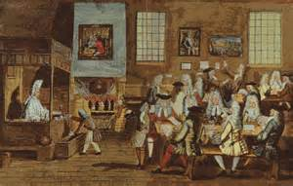
European Daily Life
The Commercial Revolution:
Expanded Trade and the empire
Began to Surpass the nobility in both wealth and power
Hereditary Nobles:
Relied on rents from their lands for wealth
Rich Entrepreneurs:
Set trends in life styles
Often met at Coffeehouses
The Peasants:
Worked like animals
Lived in Hovels
Survived on a diet of water, black bread, and roots

Slide 5
A Global Exchange
Europe’s population grew rapidly
In 1450, 55 million people-by 1650, 100 million people
More demands on goods and services. This contributed to a worldwide exchange of:
People, goods, technologies, ideas, disease, culture, and religion.
Europeans brought wheat, grapes, and livestock to the Americas.
From Native Americans: corn, potatoes, tomatoes, beans, and chocolate.
From Asia and Africa: bananas, tea, sugarcane, ivory, perfumes, silk, and gems

Slide 6
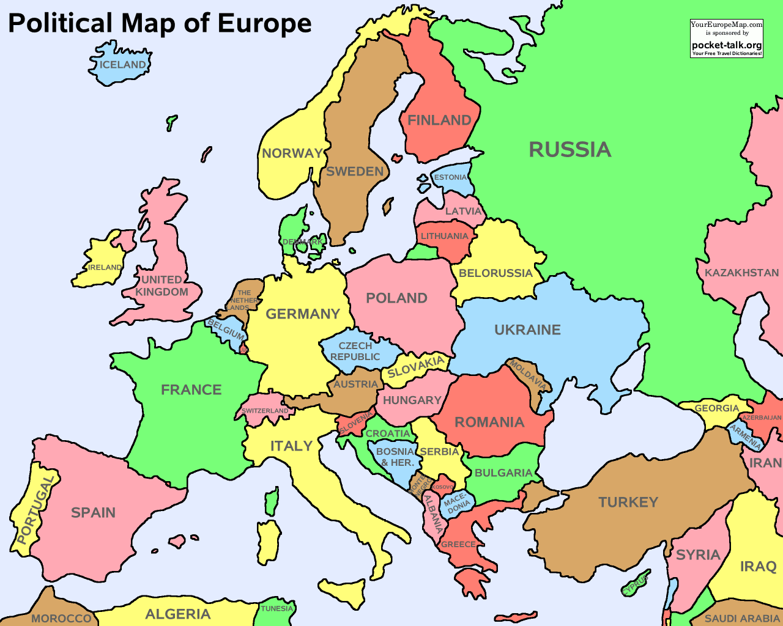
Augsburg-The Fuggers Family was from Augsburg, Germany.
Florence- The Medici Family was from Florence, Italy.

Slide 7
Additional Information
Types of Coins: Groat, Halfgroat, Penny, Halfpenny, and Farthing
English Groat- made of Silver-coins measured 26mm in diameter and weighed approximately 3.5 grams
Groat was worth about 4 pence (plural for penny)
Halfgroat- worth 2 pence
1Shillings=12 pence(3 groats)
1 pound=20 shillings so 1 pound=240 pence
For a gallon of ale was about 0.75 pence
No paper money

