Slide 1
The Middle Ages

Slide 2
Ancient World
Before 476
Modern World
After 1500
476 A.D.
1500 A.D.
1050 A.D.
1270 A.D.
Early
Middle Ages
Late
Middle Ages
High Middle Ages
Fall of Western Roman Empire
The Renaissance & Exploration

Slide 3
Merovingian Dynasty
(MEHR-uh-VIHN-jee-uhn)
Strongest Germanic group in the 3rd Century
The Franks
481 A.D.
Clovis
Key Term:
Mayor of the Palace
714 A.D.
Charles Martel
(The Hammer)
Before Pepin, the pope had political ties with the Byzantines
Pepin the Short
Charlemagne

Slide 4
Review Question
What group was the strongest Germanics during the 3rd century?
a. Lombards
b. Merovingians
c. Vikings
d. Franks

Slide 5
Review Question - ANSWER
What group was the strongest Germanics during the 3rd century?
a. Lombards
b. Merovingians
c. Vikings
d. Franks

Slide 6
Review Question
Before Pepin, the pope had political ties with the
a. Lombards
b. Muslims
c. Carolingian dynasty
d. Byzantine Empire

Slide 7
Review Question - ANSWER
Before Pepin, the pope had political ties with the
a. Lombards
b. Muslims
c. Carolingian dynasty
d. Byzantine Empire

Slide 8
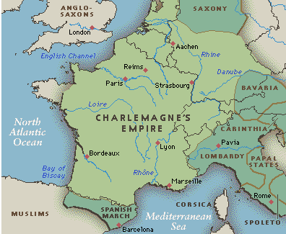
Charlemagne
“Charles the Great”
Expanded Frankish lands
Unification of government
Key Term:
Counts
Christian Roman Empire
Carolingian Renaissance
Revival of education
Schools
Grammar, logic, rhetoric, science, and religion

Slide 9
Charlemagne
Died in 814
Louis the Pious
Charles the Bald
Treaty of Verdun
Lothair
Louis the German
Carolingian Dynasty Divided = Weak

Slide 10
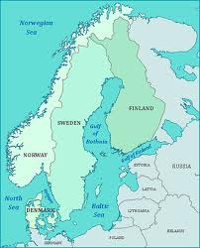
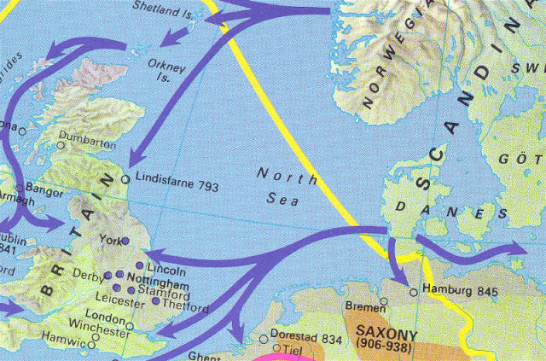
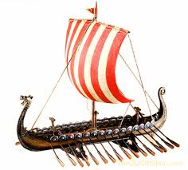
Vikings
Surprise attacks
Major threat to Europe’s mainland
Overpopulation and scare resources led to leaving Scandinavia
Invasion at Lindisfarne, England
Viking Ships
Scandinavia

Slide 11
Review Question
Why did the Vikings leave Scandinavia?
a. Charlemagne was too powerful and needed to be stopped
b. overpopulation
c. needed more resources
d. feudalism was a growing trend in Scandinavia

Slide 12
Review Question - ANSWER
Why did the Vikings leave Scandinavia?
a. Charlemagne was too powerful and needed to be stopped
b. overpopulation
c. needed more resources
d. feudalism was a growing trend in Scandinavia

Slide 13
Medieval Life
Key Term:
Feudalism
Concept began with Charles Martel in the 700s
Became a prominent practice in the 900s
Key Term:
Knights
Government by a code of chivalry (Key Term)
Manor is self sufficient – important because trade was difficult due to war
Peasants = work for protection
Serfs = peasants who could not leave without permission
Served as the relationship between nobles/peasants
Key Term:
Manorialism
Three-field system
Simplified agriculture/more production
Eliminated the use of oxen (a slower animal)

Slide 14
Manorialism
Feudalism
economic alliance between lords and peasants; provided protection in exchange for labor
political alliance of mutual protection between kings and nobles of varying degree of power

Slide 15
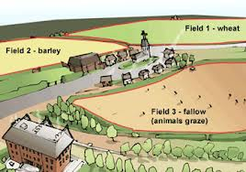
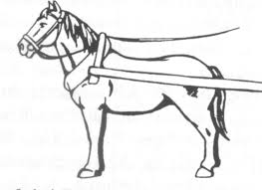
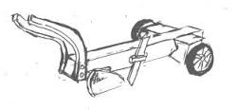
Agricultural Advances
Horses replaced the ox
Three-field system
Collar harness
Heavier plow

Slide 16
Hierarchy System of Feudalism
A Lady held very few rights, if any
Land
King
Homage
Nobility
Key Term:
Lords
Key Term:
Lady
Land
Key Term:
Homage
Key Terms:
Knights/Vassals
Protection
Key Term:
Peasants
Rent
Key Term:
Serfs

Slide 17
Medieval Life (cont.)
Fief
Consisted of peasants, land, and a castle
Key Term:
Tournament
Mock battles between knights
http://www.youtube.com/watch?v=1Rtm6pWyog8
Peasant Life
Could not fight in tournaments
Farmed land, made shoes, beer, wine, and candles
http://education-portal.com/academy/lesson/yeomanry-a-day-in-the-life-of-an-english-peasant.html#lesson

Slide 18
Review Question
Who held almost total authority within a fief?
a. lord
b. lady
c. king
d. serf

Slide 19
Review Question - ANSWER
Who held almost total authority within a fief?
a. lord
b. lady
c. king
d. serf

Slide 20
Medieval Church
Catholic Church was central to European life at all levels of society
Sacraments = salvation
Masses were said in Latin
Powerful!
Church corruption/
Heresy
Church reform/
Friars
Lay investiture
The Jews
The Inquisition

Slide 21
Review Question
What term refers to the denial of basic church teachings?
a. excommunication
b. the Inquisition
c. heresy
d. friars

Slide 22
Review Question - ANSWER
What term refers to the denial of basic church teachings?
a. excommunication
b. the Inquisition
c. heresy
d. friars

Slide 23
Medieval Church (cont.)
Monastery/Convent Life
Minimal vocal communication/ rule of silence
Key Term:
Abbot
Key Term:
Abbess
Spinning, weaving, needlework, medicinal study
Benedictine Rule
Monte Cassino monastery in Italy
(529 A.D.)
Became the guideline for medieval monasteries
-Lived a simple life
-Could not own goods
-No marriage
-Bound to monastic laws
-Life of poverty, chastity, and obedience
-preserved biblical and classical writings
During the Late Middle Ages, church power began to weaken

Slide 24
Pop Quiz Question
What feature of the Vikings aided in successful invasions?
a. helmets
b. trade
c. sagas
d. culture
e. ships
f. chivalry

Slide 25
Pop Quiz Question - ANSWER
What feature of the Vikings aided in successful invasions?
a. helmets
b. trade
c. sagas
d. culture
e. ships
f. chivalry

Slide 26
Rise of European Monarchy
England
Anglo-Saxons
Alfred the Great
Similar to Charlemagne/education
United his kingdom = England
History of England – Anglo-Saxon Chronicle
Norman Conquest
William the Conqueror
From Normandy, France
Battle of Hastings
Harold Godwinson fights for throne
Domesday Book

Slide 27
Pop Quiz Question
What was the goal of the Inquisition?
a. to take back the holy land
b. to increase revenue
c. seek out and punish heretics
d. reform the medieval church
e. encourage competition
between workers
f. keep women out of the
work force

Slide 28
Pop Quiz Question - ANSWER
What was the goal of the Inquisition?
a. to take back the holy land
b. to increase revenue
c. seek out and punish heretics
d. reform the medieval church
e. encourage competition
between workers
f. keep women out of the
work force

Slide 29
Rise of European Monarchy
England
Henry I
Knights murdered Thomas a Becket (archbishop of Canterbury)
Henry II
Eleanor of Aquitaine
Magna Carta
“Great Charter”
1215
John
Richard I
(the Lionheart)
Henry III
Major population growth = establishment of middle class

Slide 30
Review Question
What did the Magna Carta accomplish?
a. eliminated the power of the monarchy
b. denied the king freedom to tax nobles without their consent
c. regulated the work of guild members
d. excommunicated the king and all clergy members

Slide 31
Review Question - ANSWER
What did the Magna Carta accomplish?
a. eliminated the power of the monarchy
b. denied the king freedom to tax nobles without their consent
c. regulated the work of guild members
d. excommunicated the king and all clergy members

Slide 32
Rise of European Monarchy
France
Hugh Capet (987 A.D.)
Central government
Phillip II/Phillip Augustus
Louis IX
Hundred Years’ War

Slide 33
Pop Quiz Question
What term refers to the relationship between nobles and peasants?
a. chivalry
b. fiefs
c. manorialism
d. feudalism
e. vassals
f. homage

Slide 34
Pop Quiz Question - ANSWER
What term refers to the relationship between nobles and peasants?
a. chivalry
b. fiefs
c. manorialism
d. feudalism
e. vassals
f. homage

Slide 35
Rise of European Monarchy
Holy Roman Empire
-disputes between Germany and the pope
-Otto I/Otto the Great
-Gregory VII stopped lay investiture
-Concordat of Worms

Slide 36
The Crusades
Nine in total
Christian invasion to take back Jerusalem/Palestine
Byzantine Empire asks for help
November 1095
First Crusade
Third Crusade
Many Muslims/Jews killed
Entire populations massacred
Two month siege
Success reinforced church authority
“Crusade of Kings”
Saladin captures Jerusalem (1187)
Phillip Augustus/Richard I
Second Crusade
Fifty years later
Seljuk Turks reconquer
Turk victory
Effects of the Crusades

Slide 37
Review Question
What was the ultimate purpose of the Crusades?
a. free Rome form the Byzantines
b. reform the church
c. seek out and punish heretics
d. keep the Holy Land out of
Muslim control

Slide 38
Review Question - ANSWER
What was the ultimate purpose of the Crusades?
a. free Rome form the Byzantines
b. reform the church
c. seek out and punish heretics
d. keep the Holy Land out of
Muslim control

Slide 39
Pop Quiz Question
The behavior of knights was governed by what?
a. homage
b. fief
c. chivalry
d. heresy
e. investiture
f. manorialism

Slide 40
Pop Quiz Question - ANSWER
The behavior of knights was governed by what?
a. homage
b. fief
c. chivalry
d. heresy
e. investiture
f. manorialism

Slide 41
Pop Quiz Question
What led to self-sufficiency of the manor during the feudal era?
a. new kind of plow
b. harder working serfs
c. fiefs
d. heavy taxation
e. migration
f. the crusades

Slide 42
Pop Quiz Question - ANSWER
What led to self-sufficiency of the manor during the feudal era?
a. new kind of plow
b. harder working serfs
c. fiefs
d. heavy taxation
e. migration
f. the crusades

Slide 43
-Economic revival – 1000 A.D.
-Rebuilding of Roman roads
-Three field system development
-Money economy
Economic & Cultural Revival
-education controlled by clergy
-middle class
-burgesses/bourgeoisie
-scholasticism (Thomas Aquinas)
-Literature
-Troubadours
-Vernacular
-Gothic Architecture
-Art
http://education-portal.com/academy/lesson/gothic-art-and-architecture.html#lesson
-town development
-defense walls
-minimal sanitation = disease
-merchant guilds
-craft guilds

Slide 44
Review Question
Which of the following is a function of a craft guild?
a. keep women out of the workforce
b. regulate the work of their members
c. create gothic architecture
d. eliminate vernacular

Slide 45
Review Question - ANSWER
Which of the following is a function of a craft guild?
a. keep women out of the workforce
b. regulate the work of their members
c. create gothic architecture
d. eliminate vernacular

Slide 46
Pop Quiz Question
What is the term that refers to wandering preachers who encouraged Catholic loyalty during the A.D. 1200s?
a. friars
b. monks
c. priests
d. fiefs
e. cardinals
f. abbots

Slide 47
Pop Quiz Question - ANSWER
What is the term that refers to wandering preachers who encouraged Catholic loyalty during the A.D. 1200s?
a. friars
b. monks
c. priests
d. fiefs
e. cardinals
f. abbots

Slide 48
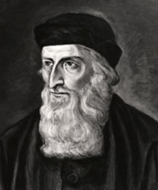
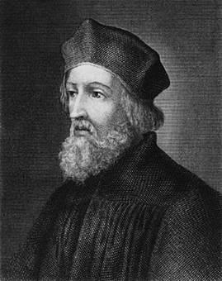
John Wycliffe
Jon Hus

Slide 49
Pop Quiz Question
What happened to the Church’s power and authority during the late Middle Ages?
a. increased
b. dispersed across Europe
c. dispersed across the Mediterranean
d. weakened
e. split
f. migrated to Jerusalem

Slide 50
Pop Quiz Question - ANSWER
What happened to the Church’s power and authority during the late Middle Ages?
a. increased
b. dispersed across Europe
c. dispersed across the Mediterranean
d. weakened
e. split
f. migrated to Jerusalem

Slide 51
Pop Quiz Question
In the A.D. 1000s, Jerusalem was taken over by whom?
a. Ottoman Turks
b. Moors
c. Jews
d. Christians
e. Seljuk Turks
f. Mongols

Slide 52
Pop Quiz Question - ANSWER
In the A.D. 1000s, Jerusalem was taken over by whom?
a. Ottoman Turks
b. Moors
c. Jews
d. Christians
e. Seljuk Turks
f. Mongols

Slide 53
Review of Byzantine Culture
Which emperor established the capital of Constantinople?
Constantine
He converted to which religion?
Christianity
What was Justinian’s goal for his empire?
To rebuild Rome & gain control of the Mediterranean
What invisible threat invaded Constantinople during Justinian’s reign?
The Black Plague/Bubonic Plague

Slide 54
The Middle Ages in 3 ½ Minutes
http://www.youtube.com/watch?v=6EAMqKUimr8
Remember…your test is on Thursday!
Items to review:
Middle Ages map
Notes
This PowerPoint is posted on Edmodo – review it!
Optional homework assignment from yesterday – more are available if you need a copy
Your only homework is to study!
Remember, you’re almost juniors and with that comes more academic responsibility. Study hard!
If you have any questions, come see me tomorrow, before or after school

